Slide 1

CMR COLLEGE OF ENGINEERING & TECHNOLOGY
Kandlakoya, Medchal, Hyderabad - 501401
Department of Computer Science and Engineering
Huffman Based LZW Lossless Image
Compression Using Retinex Algorithm
Batch No:28
Name of the student:
R. Yeshwanth Raju - 20H51A0546
M. Pavan Kumar - 20H51A05H6
Under esteemed guidance of
Mr. BK. Chinna Madhileti (Assistant Professor)
Batch: 2020-2024 Major Project Phase 2

Slide 2
Outline
Abstract
Introduction
Research Objective
Problem Definition
Scope of the Project
Literature Review
Implementation of Existing system
Proposed Method Description
Architecture/Block diagram
Result
Conclusion
References
Notes:
2

Slide 3
Abstract
Notes:
3

Slide 4
ABSTRACT
• Image compression is an application of data compression that encodes the
original image with few bits. The objective of image compression is to reduce
irrelevance and redundancy of the image data in order to be able to store or
transmit data in an efficient form.
• So Image compression can reduce the transmit time over the network and
increase the speed of transmission. In Lossless image compression no data
loss when the compression technique is done.
• In this research, a new lossless compression scheme is presented and named
as Huffman Based LZW Lossless Image Compression using Retinex Algorithm
which consists of three stages: In the first stage, a Huffman coding is used to
compress the image. In the second stage all Huffman code words are concaten-
ated together and then compressed with LZW coding and decoding.
• In the third stage the Retinex algorithm are used on compressed image for ,
enhance the contrast of image and improve the quality of image.This proposed
technique is used to increase the compression ratio.

Slide 5
INTRODUCTION
Notes:
5

Slide 6
Introduction
Image compression is an application of data compression that encodes the
original image with few bits. The objective of the image compression is to
reduce irrelevance and redundancy of the image data in order to be able to
store or transmit data in an efficient form.
Image compression means the reduction of the size image data, while retaining
necessary information. Mathematically this means transforming a 2D pixel array
in to a statically uncorrelated data set.
The transformation is applied prior to storage or transmission of the image. At
late time the compressed image is decompressed to reconstruct the image and
an approximation of it.
So image compression is used to minimize the amount of memory needed to
represent an image. Images often require a large number of bits to represent
them, and if the image needs to be transmitted or stores, it is impractical to do
so without somehow reducing the number of bits.
Notes:
6

Slide 7
Research Objective
Notes:
7

Slide 8
Research objective
The main objective is to compress the size of the image, without reducing
the image data.
It is a multidisciplinary approach that combines image compression and
enhancement techniques.
The aim is to achieve high quality, lossless compression while improving
the visual quality of the images. It has implications in various fields like
image archiving, medical imaging where compression efficiency and image
quality are critical.

Slide 9
Problem Definition
Notes:
9

Slide 10
Problem Definition
The study aims to identify the specific challenges and objectives of this research or project. It is essential for applications that require the faithful reconstruction of the original images.
The problem at hand is to develop an efficient and effective image compression method that combines Huffman coding with LZW to achieve lossless compression while integrating the Retinex algorithm for image enhancement.
This research will provide a comprehensive solution that has applications in various fields where compression efficiency and image quality are of the paramount importance.

Slide 11
Scope of the Project
Notes:
11

Slide 12
Scope of the Project
The scope of the project encompasses the development of a lossless
image compression method that integrates Huffman coding, LZW compression,
and the Retinex algorithm.
It includes research, experimentation, evaluation, and may involve the
development of a prototype implementation.
The primary focus is on improving compression efficiency while enhancing
image quality, with an eye towards real-world applications.
The project will include subjective image quality assessment to ensure that
the Retinex-based enhancements improve the visual quality of compressed
images without sacrificing diagnostic or informative value.

Slide 13
Literature Review
Notes:
13

Slide 14
Comparison table for the existing system
S.No | Authors and Journal Name& Year of publication | Problem Statement | Name of the Proposed solution/Method | Solution | Remarks
1. | Lossless-JPEG compression method, also known as JPEG-LS. Authors : William A Pearlman Amir | The problem is to develop a lossless image compression method that reduces image file sizes without any loss of image data. The objective is to create a compression technique that can store images more efficiently while enabling exact reconstruction. | The proposed solution for lossless JPEG compression is referred to as "JPEG-LS.“ (JPEG-Lossless) | The Lossless JPEG, or JPEG-LS, is a method of image compression that reduces the size of image files without any loss of image data. It is a widely used standard for preserving image quality during compression, making it suitable for applications where image fidelity is essential, such as medical imaging. | Lossless JPEG, or JPEG-LS, is a valuable image compression method that maintains image quality while reducing file size. It's well-suited for applications where preserving image fidelity is critical.
2. | Run-Length Encoding (RLE) Author : David A Terry Welch Burrows and Wheeler | The problem that Run-Length Encoding (RLE) addresses is how to efficiently represent data sequences with long runs of the same value by reducing them to a shorter form for compression purposes. | The proposed solution or method for RLE is Run-Length Encoding. | RLE is a simple data compression technique used to store consecutive repeated values as a single value followed by the count of r. It's often used as a simple example in computer science and data compression courses to illustrate the principles of data compression. | RLE is a basic and efficient compression technique for specific types of data with long runs of the same value, but it may not be the best choice for all types of data. Its simplicity and lack of data loss make it suitable for certain applications, but for more advanced compression needs, other algorithms are typically preferred.

Slide 15
Comparison table for the existing system
S. No | Authors and Journal Name& Year of publication | Problem Statement | Name of the Proposed solution/Method by authors | Solution | Remarks
3. | Wavelet compression Authors : Ingrid-Daubechies Stephane - Mallat | The wavelet compression revolves around finding techniques that can efficiently reduce the size of data while preserving important information, making them well-suited for various applications like image and signal compression, transmission, and storage. | The proposed solution for the Wavelet compression referred to as “WC”. | Wavelet compression is a data compression technique that uses wavelet transforms to efficiently reduce the size of data while preserving important features. The solution involves the following key steps : Wavelet transform, Quantization etc. | In summary, Wavelet compression is a powerful and flexible technique that is widely used in image and signal compression. It offers an excellent trade-off between compression and quality, making it suitable for various applications where data reduction is needed while retaining important features.
4. | Tagged Image File Format (TIFF) Authors: Aldus corporation | The problem was to create a standardized and versatile image file format that could address the diverse needs of the computer graphics, publishing, and imaging industries | The proposed solution for the Tagged Image File Format referred to as “TIFF”. . | The Solution for TIFF is to develop a format that could accommodate various types of image data, maintain high-quality image fidelity, and support a broad range of applications and attributes. | TIFF is a widely adopted and enduring image format that excels in preserving image quality, color accuracy, and compatibility across diverse applications. Its flexibility, adaptability, and support for various image attributes contribute to its continued importance in the world of digital imaging and content management.

Slide 16
Comparison table for the existing system
S. No | Authors and Journal Name& Year of publication | Problem Statement | Name of the Proposed solution/Method by authors | Solution | Remarks
5. | Joint Photographic Experts Group (JPEG 2000) Author: Touradj-Ebrahimi David-Taubman Michael Marcellin | The problem was to develop a more advanced and efficient image compression standard to address the limitations of existing image compression methods, including the original JPEG (Joint Photographic Experts Group). | The proposed solution and method for the JPEG 2000 image compression standard were developed by the Joint Photographic Experts Group (JPEG), which is a committee of experts responsible for developing and maintaining image compression standards | The challenge was to create a standard that could efficiently compress images while preserving high-quality image detail and adapt to a wide range of applications, including those with varying bandwidth and storage constraints. | JPEG 2000 is a versatile and advanced image compression standard that successfully addresses the need for high-quality image compression while adapting to a wide range of applications. Its scalability, transparency support, and advanced coding techniques have established it as a valuable format for industries where both image quality and efficient compression are paramount.

Slide 17
Implementation of Proposed System
1. Huffman Coding and Decoding Process
Huffman Encoding Algorithms use the probability distribution of the alphabet of the source to develop the code words for symbols. The frequency distribution of all the characters of the source is calculated in order to calculate the probability distribution.
According to the probabilities, the code words are assigned. Shorter code words for higher probabilities and longer code words for smaller probabilities
are assigned. For this task a binary tree is created using the symbols as leaves according to their probabilities and paths of those are taken as the code words.
Two families of Huffman Encoding have been proposed: Static Huffman
Algorithms and Adaptive Huffman Algorithms. Static Huffman Algorithms calculate the frequencies first and then generate a common tree for both the compression and decompression processes

Slide 18
Implementation of Proposed System
2. ALGORITHM
Read the image on to the workspace of the mat lab.
Call a function which will find the symbols (i.e. pixel value which is non-repeated).
Call a function which will calculate the probability of each symbol.
Probability of symbols are arranged in decreasing order and lower probabilities are merged and this step is continued until only two probabilities are left and codes are assigned according to rule that the highest probable symbol will have a shorter length code.
Further Huffman encoding is performed i.e. mapping of the code words to the corresponding symbols will result in a Huffman codeword’s
Concatenate all the Huffman code words and apply Lzw encoding will results in Lzw Dictionary and final encoded Values (compressed data).
Apply Lzw decoding process on Final Encoded values and output the Huffman code words
Apply Huffman Encode value on the LZW Encoding process.
final apply the Multiscale Retinex Algorithm on compressed image to enhance the quality and color of the mage.
In last step the Recovered image is generated

Slide 19
Proposed Method Description
This paper proposes a compression technique using the two lossless
methodologies Huffman coding and Lempel Ziv Welch coding to compress
image. In the first stage, the image is compressed with Huffman coding resulting
the Huffman tree and Huffman Code words. In the second stage, all Huffman
code words are concatenated together and then compressed by using Lempel
Ziv Welch coding. In the third stage the Retinex algorithm are used on
compressed image for enhance the contrast of image and improve the quality
of image.

Slide 20
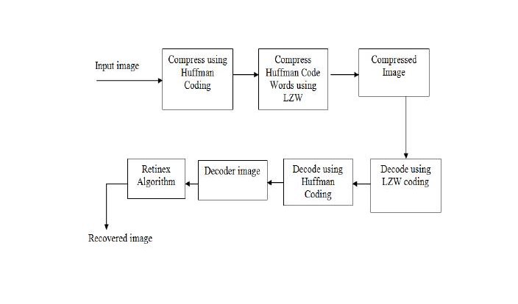
Architecture / Block Diagram

Slide 21
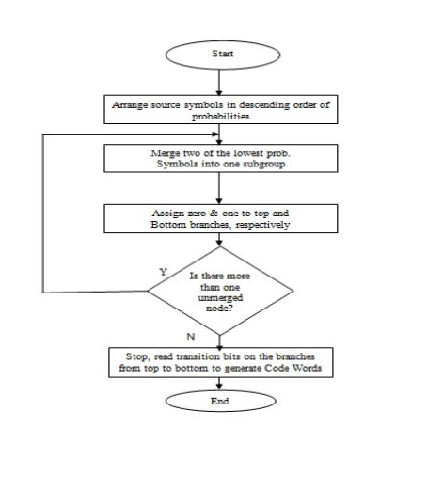
Architecture / Block Diagram

Slide 22
Result
Using Huffman coding, LZW (Lempel-Ziv-Welch) compression, and the Retinex algorithm for image processing can provide effective lossless image compression with enhanced image quality.
The Retinex algorithm is applied for image enhancement. Retinex is a color and brightness perception model that aims to improve the visual appearance of images by enhancing details, reducing shadows, and correcting for uneven illumination.
Finally the combination of Huffman and LZW compression, along with the Retinex enhancement, ensures that you achieve high compression efficiency without compromising image quality

Slide 23
Conclusion
In this project Overall, Huffman-based LZW lossless image compression with the Retinex algorithm is a versatile and effective solution for scenarios where both image compression and visual enhancement are of paramount importance. Its utility extends to a wide range of applications, including those that demand preservation of image fidelity, such as medical imaging, archival storage, and remote sensing.

Slide 24
References
Vartika Singh “A Brief Introduction on Image Compression Techniques and Standards” International Journal of Technology and Research Advances Volume of 2013 issue.
Mamta Sharmap “Compression Using Huffman Coding” IJCSNS International Journal of Computer Science and Network Security, VOL.10 No.5, May 2010.
Sindhu M, Rajkamal R“Images and Its Compression Techniques A Review” International Journal of Recent Trends in Engineering, Vol 2, No. 4, November 2009.
R.S.Aarthi, D. Muralidharan, P. Swaminathan “DOUBLE COMPRESSION OF TEST DATA USING HUFFMAN CODE ” Journal of Theoretical and Applied Information Technology 15 May 2012

Slide 25
Thank You!

